Slide 1
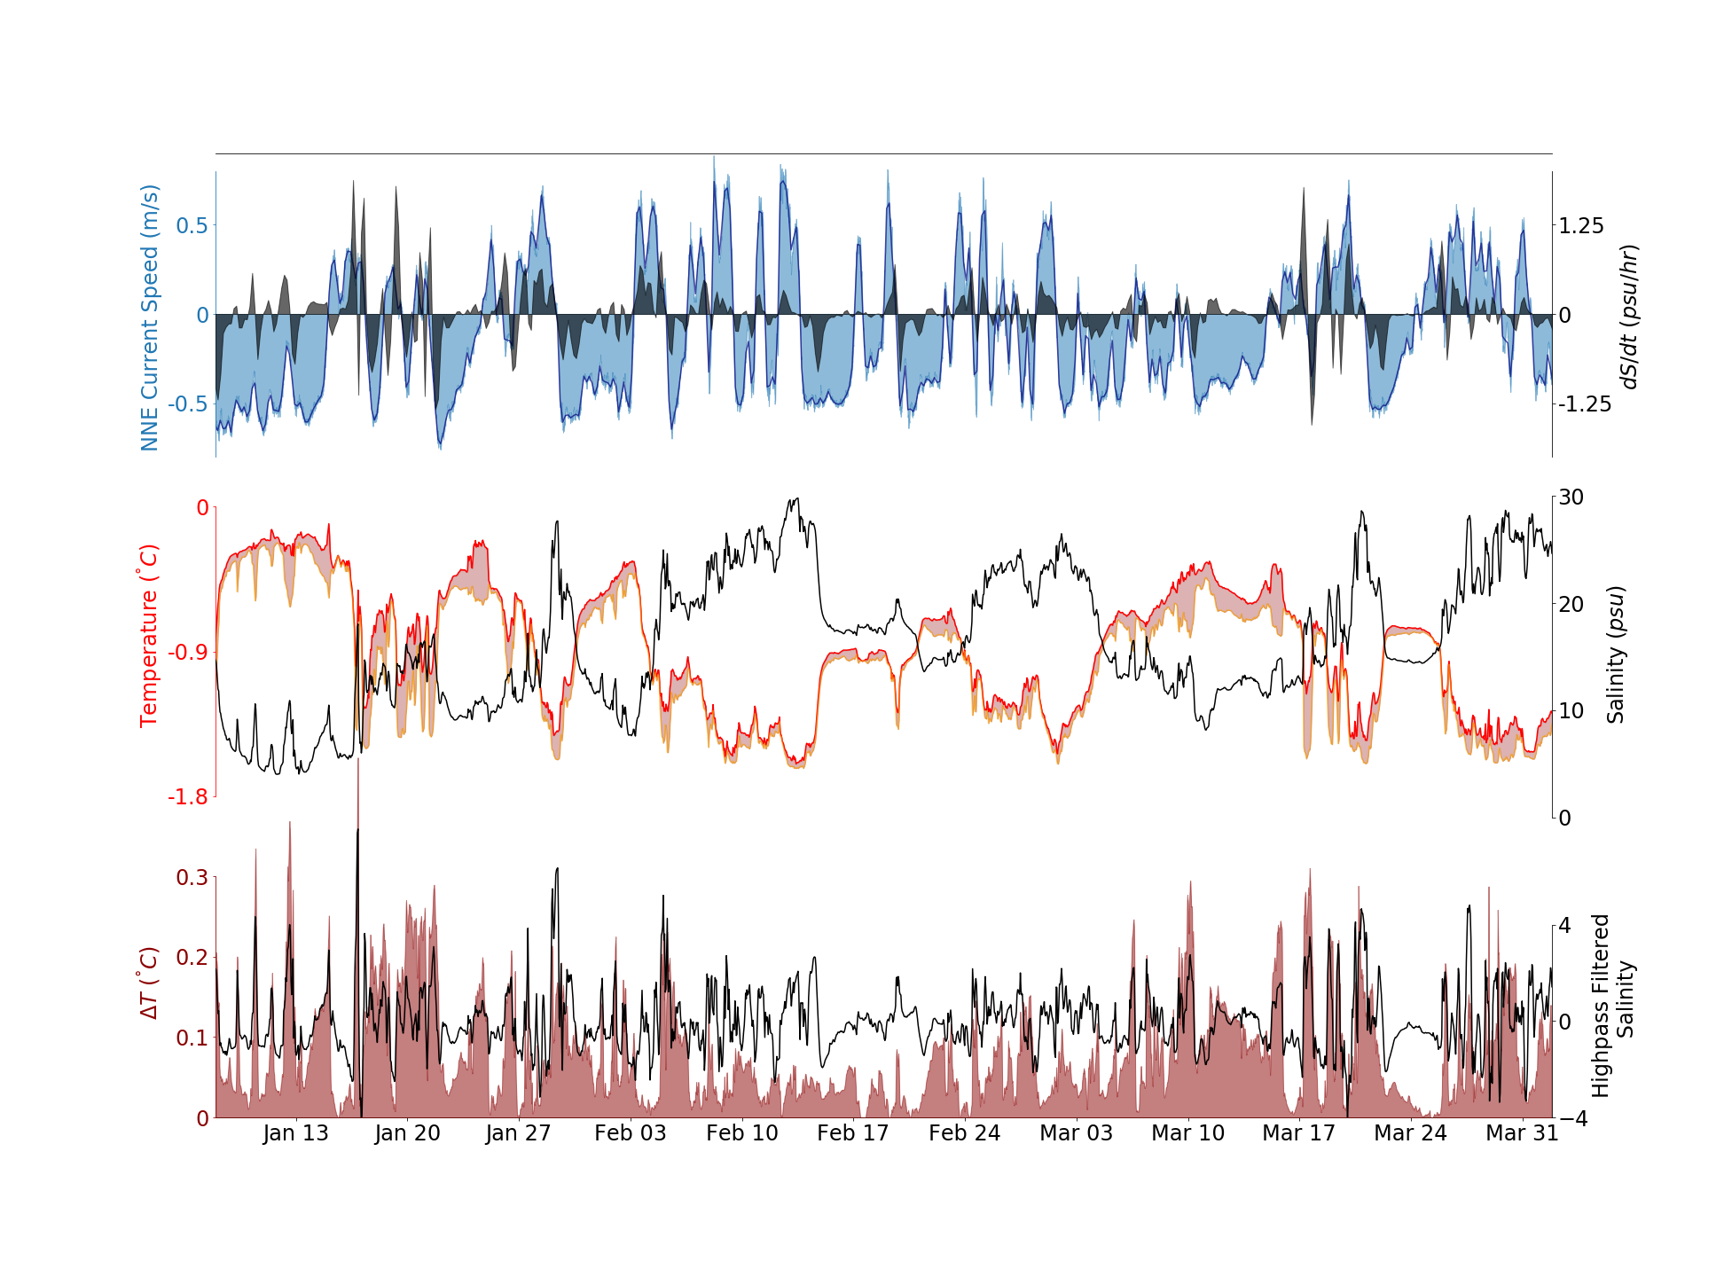
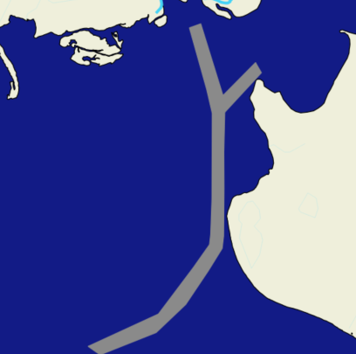
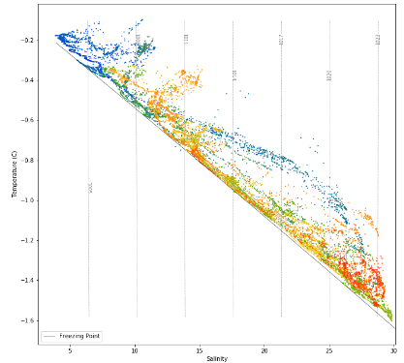
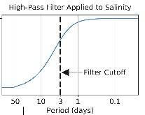

Relationships between Flow Direction, Salinity Changes, and Departures from the Freezing Point
N
Flow direction:
(+) upriver
(–) downriver
negative values of dS/dt (above) mean that salinity (below) is decreasing
Shaded regions are highlighted in this T-S diagram
a
b
c
ΔT
Freezing Point
A high-pass filter applied to the salinity removes the long-term trends
(>3 days)
Notes:
Causal interpretation:
Salinity increases on the timescale of 12hrs-2days are caused by weakening of the downriver flow, and lead to departures from the freezing point.

Slide 2
Relationships between Flow Direction, Salinity Changes, and Departures from the Freezing Point
N
Flow direction:
(+) upriver
(–) downriver
a
b
c
ΔT
Freezing Point
Notes:
Causal interpretation:
Salinity increases on the timescale of 12hrs-2days are caused by weakening of the downriver flow, and lead to departures from the freezing point.

